Slide 1




Atliq Hardware
Consumer Goods Ad-Hoc Insights

Slide 2
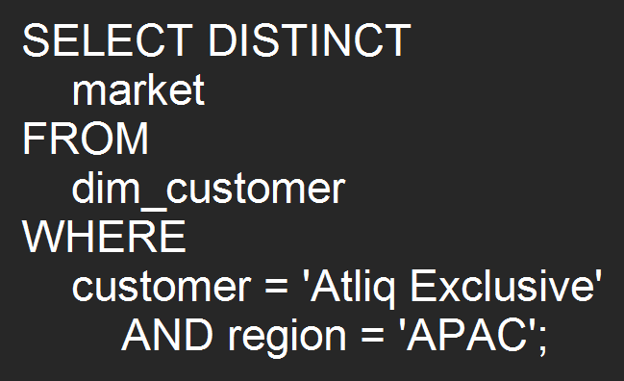
APAC Market List for 'Atliq Exclusive'
Question: Provide the list of markets in which customer "Atliq Exclusive" operates its business in the APAC region.

Slide 3
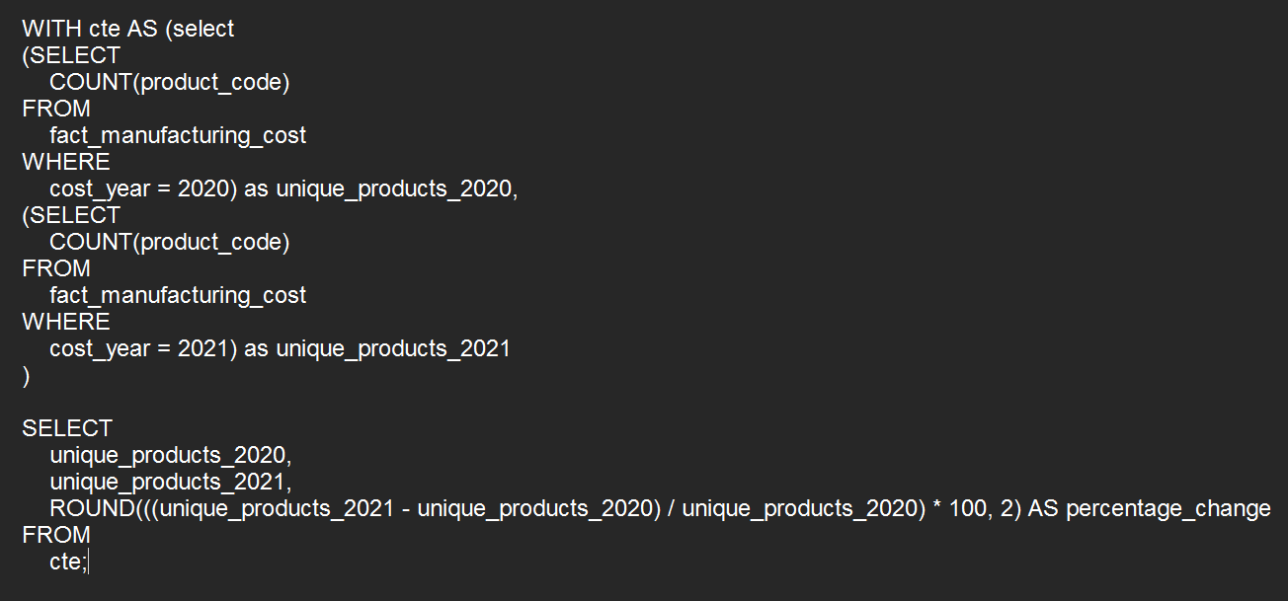
Percentage Change in Unique Products: 2021 vs. 2020
Question: What is the percentage of unique product increase in 2021 vs. 2020? The final output contains these fields: unique_products_2020, unique_products_2021, percentage_chg

Slide 4
Conversion of Output to visual
Insights
The number of unique products manufactured increased by 36.36% from 2020 to 2021.
This moderate growth reflects a steady improvement in manufacturing operations.
The consistent increase indicates positive momentum and potential for further expansion in the upcoming years.

Slide 5
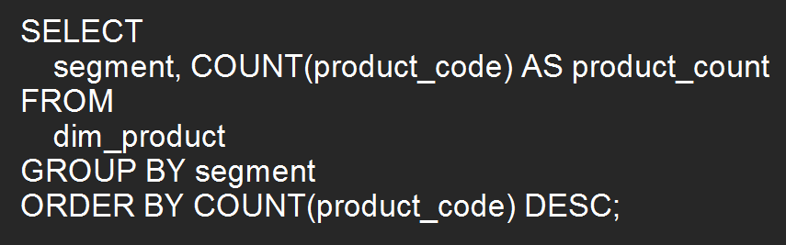
Segment-Wise Unique Product Counts
Question: Provide a report with all the unique product counts for each segment and sort them in descending order of product counts. The final output contains 2 fields: segment, product_count

Slide 6
Conversion of Output to visual
Insights
Notebook and Accessories dominate the product portfolio, accounting for the largest share with 129 and 116 products, respectively, indicating these segments are key drivers of the company's offerings.
Networking has the lowest product count (9), suggesting it might be a niche or underdeveloped segment that could benefit from strategic expansion.
Peripherals (84 products) serve as a strong mid-tier segment, showing potential for further development to bridge the gap between top-performing and lower-performing segments.

Slide 7
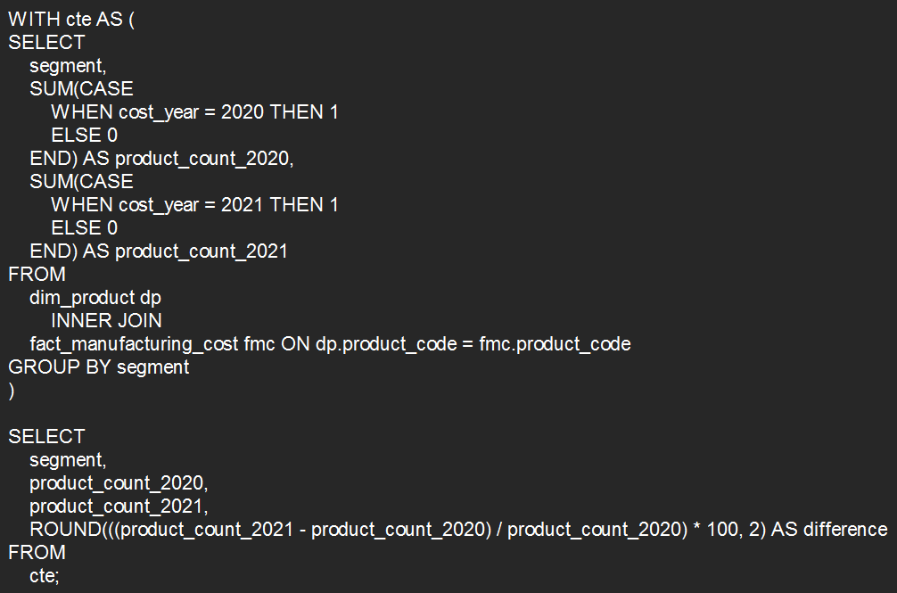
Segment with the Highest Increase in Unique Products (2021 vs. 2020)
Question: Follow-up: Which segment had the most increase in unique products in 2021 vs 2020? The final output contains these fields: segment, product_count_2020, product_count_2021, difference

Slide 8
Conversion of Output to visual
Insights
Desktop showed the highest growth at 214.29%, indicating strategic expansion.
Accessories (49.28%) and Networking (50%) experienced notable increases.
Notebook (17.39%) maintained steady growth, confirming its importance.
Moderate growth in Peripherals (27.12%) and Storage (41.67%) reflects balanced development.

Slide 9
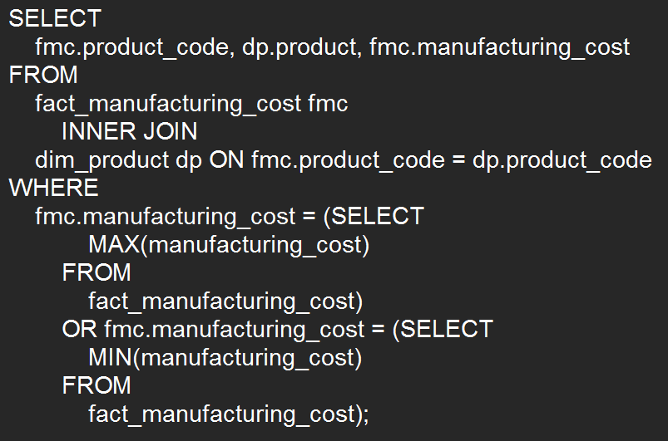
Products with the Highest and Lowest Manufacturing Costs
Question: Get the products that have the highest and lowest manufacturing costs. The final output should contain these fields: product_code, product, manufacturing_cost

Slide 10
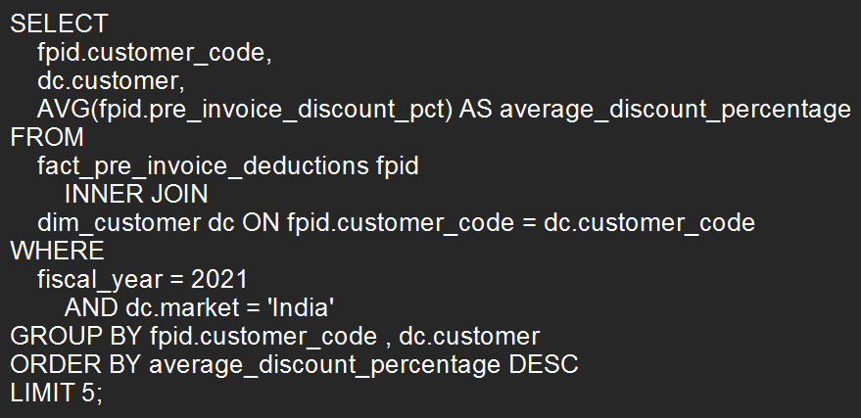
Top 5 Customers with Highest Average Pre-Invoice Discount Percentage in the Indian Market (Fiscal Year 2021)
Question: Generate a report which contains the top 5 customers who received an average high pre_invoice_discount_pct for the fiscal year 2021 and in the Indian market. The final output contains these fields: customer_code, customer, average_discount_percentage

Slide 11
Conversion of Output to visual
Insights
Flipkart (0.3083) leads with the highest discount, while Viveks (0.3038) and Ezone (0.3028) offer similar pricing.
Croma (0.3025) maintains steady pricing, aligned with competitors.
Amazon (0.2933) has the lowest discount, indicating a conservative pricing strategy.

Slide 12
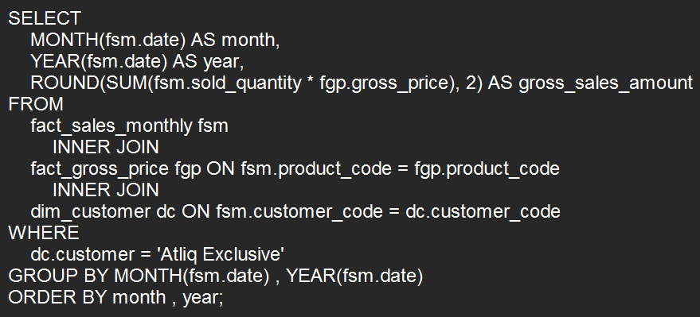
Monthly Gross Sales Report for 'Atliq Exclusive'
Question: Get the complete report of the Gross sales amount for the customer “Atliq Exclusive” for each month. This analysis helps to get an idea of low and high-performing months and take strategic decisions. The final report contains these columns: Month, Year, Gross sales Amount

Slide 13
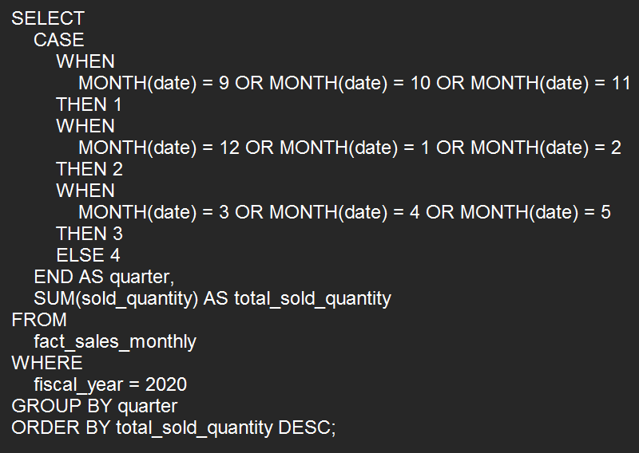
Quarter of 2020 with Maximum Total Sold Quantity
Question: In which quarter of 2020, got the maximum total_sold_quantity? The final output contains these fields sorted by the total_sold_quantity. Fields: Quarter, total_sold_quantity

Slide 14
Conversion of Output to visual
Insights
Quarter 1 (7,005,619) leads with the highest sales, followed by Quarter 2 (6,649,642) with moderate decline.
Quarter 4 (5,042,541) shows a smaller drop, while Quarter 3 (2,075,087) experiences the steepest decline.
The sales trend reflects a significant dip in Quarter 3, with quarters 1, 2, and 4 showing relatively stable performance.

Slide 15
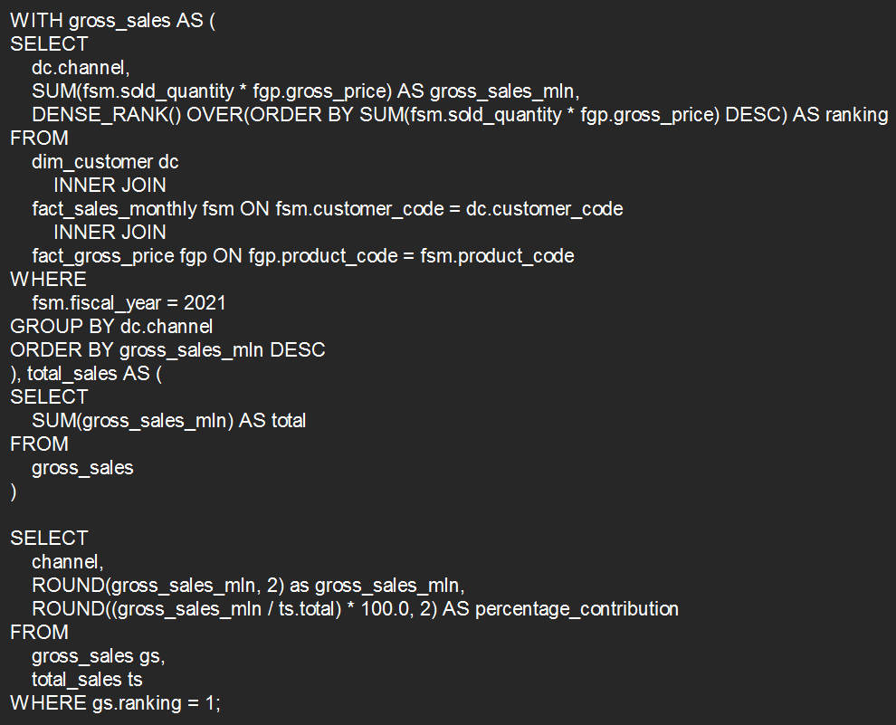
Top Channel by Gross Sales and Contribution Percentage (Fiscal Year 2021)
Question: Which channel helped to bring more gross sales in the fiscal year 2021 and the percentage of contribution? The final output contains these fields: channel, gross_sales_mln, percentage

Slide 16
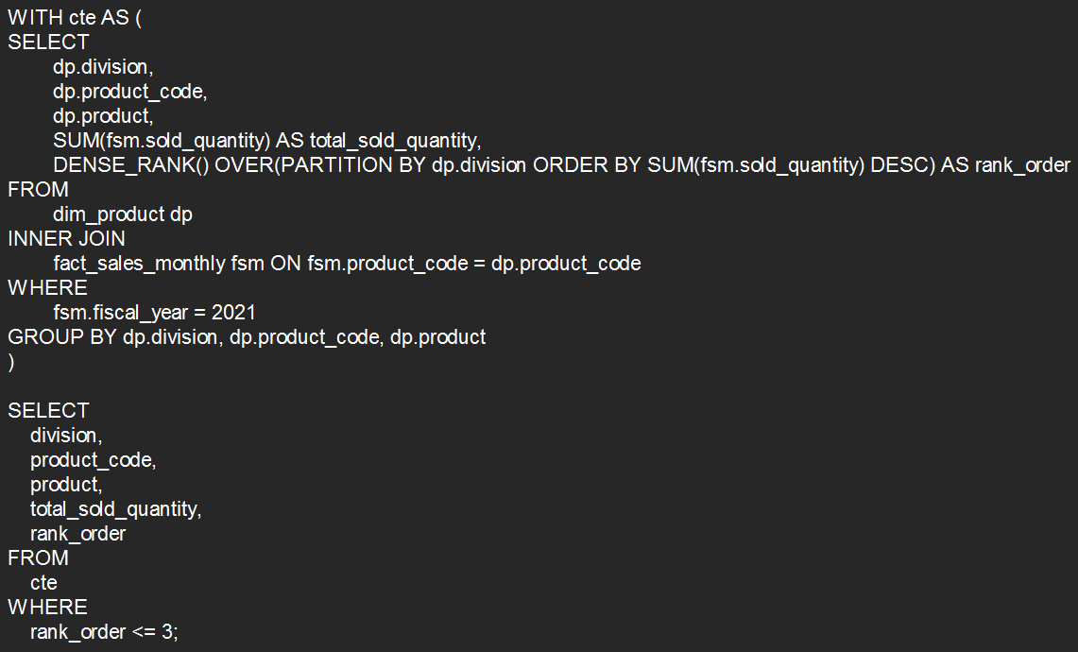
Top 3 Products by Total Sold Quantity in Each Division (Fiscal Year 2021)
Question: Get the Top 3 products in each division that have a high total_sold_quantity in the fiscal_year 2021? The final output contains these fields: division, product_code, product, total_sold_quantity, rank_order

Slide 17
Conversion of Output to visual
Insights
N & S products lead sales, with A6720160103 (701,373) topping the list.
P & A products follow, with A2319150302 (428,498) showing the highest sales in this category.
PC products show the lowest sales, with A4218110202 (17,434) leading in this group.

Slide 18
Thank You 🤗

